Slide 1

EXPLORATORY PROJECT
EC-291
1
NAVIGATION CONTROL OF A FOUR WHEELED ROBOT BASED ON HAND MOTION OF A TELE-OPERATOR
Advisor :
Dr. Thanjai L. Oppili Prasad
Ayush Kumar
22095019
Harsh Chawra
22095041
Mitul Agarwal
22095064
Rajat Kumar
22095087

Slide 2
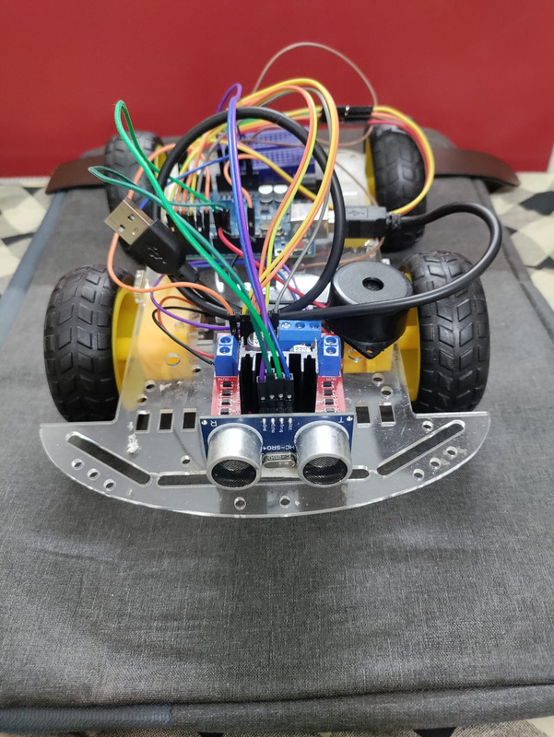
INTRODUCTION
2
The project aims to develop a 4-wheeled robot that responds to hand-based control. It uses sensors on a glove to track your hand's movements and sends the data to a microcontroller, which controls the robot. This lets you direct the robot forward, backward, left, or right with simple hand motion, creating a more natural way to control it.
IIT (BHU) | 2024

Slide 3
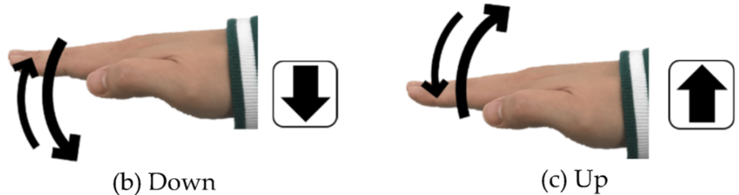
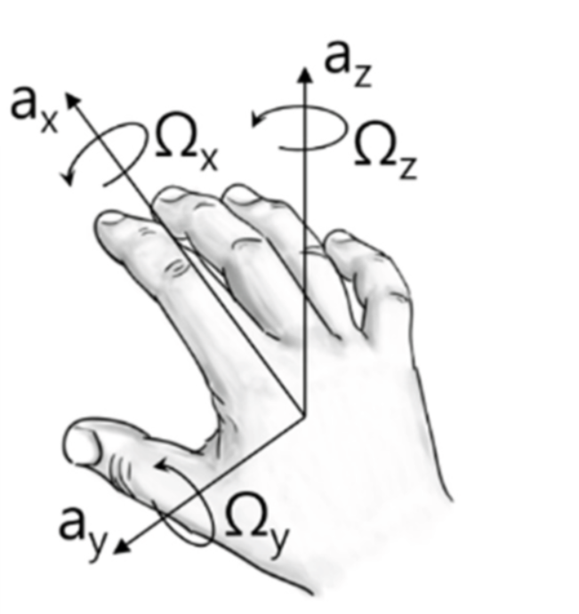

3
OPERATOR - CONTROL
FORWARD
BACKWARD
RIGHT
LEFT
IIT (BHU) | 2024

Slide 4
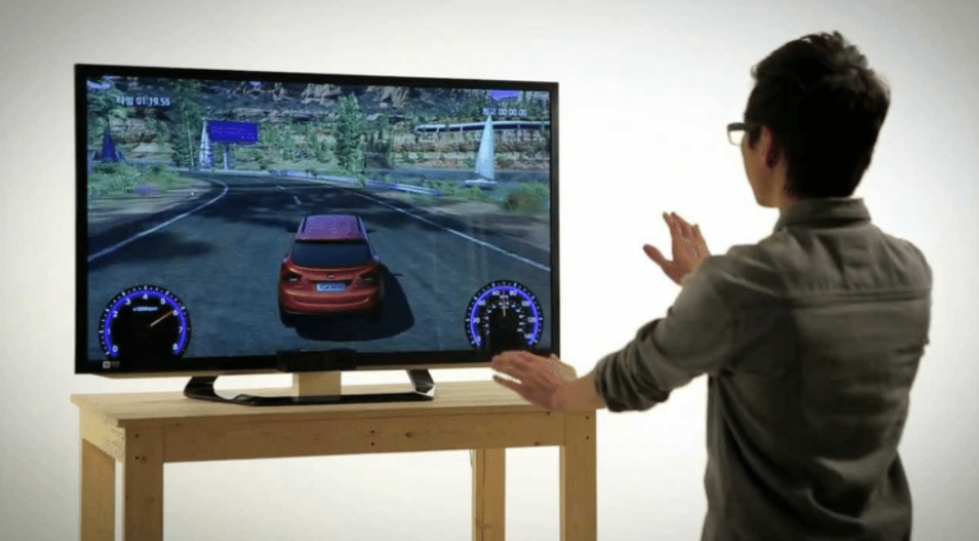

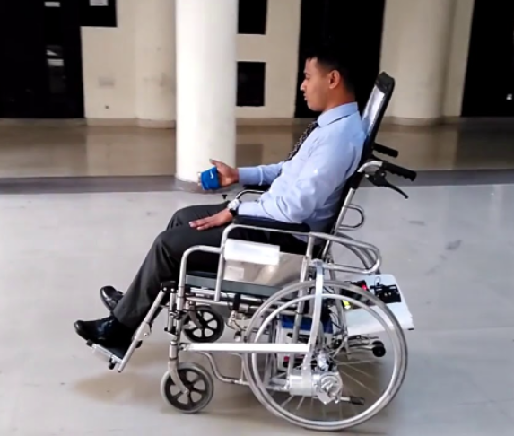
APPLICATIONS
4
GAMING
WAREHOUSE
WHEELCHAIR

Slide 5
HARDWARE - BLOCK DIAGRAM
5
Transmitter Side
Receiver Side
Power Supply
(5V)
MPU 6050 Sensor Module
Arduino
UNO
UltraSonic
Sensor
Power Supply
(5V)
DC Motors
Left And Right
Motor Driver
L293D
Buzzer
POWER
SWITCH

Slide 6
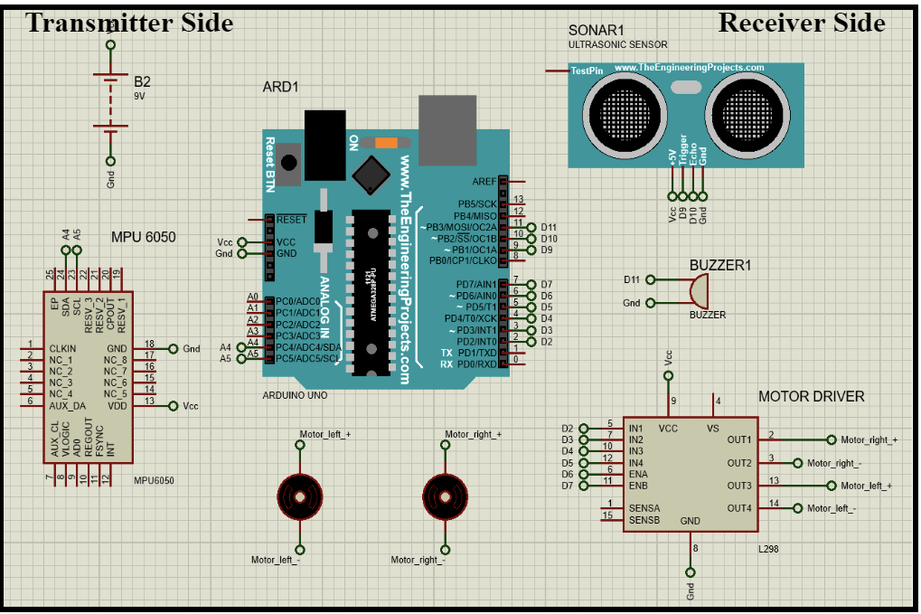
CIRCUIT IMPLEMENTATION
6
IIT (BHU) | 2024

Slide 7
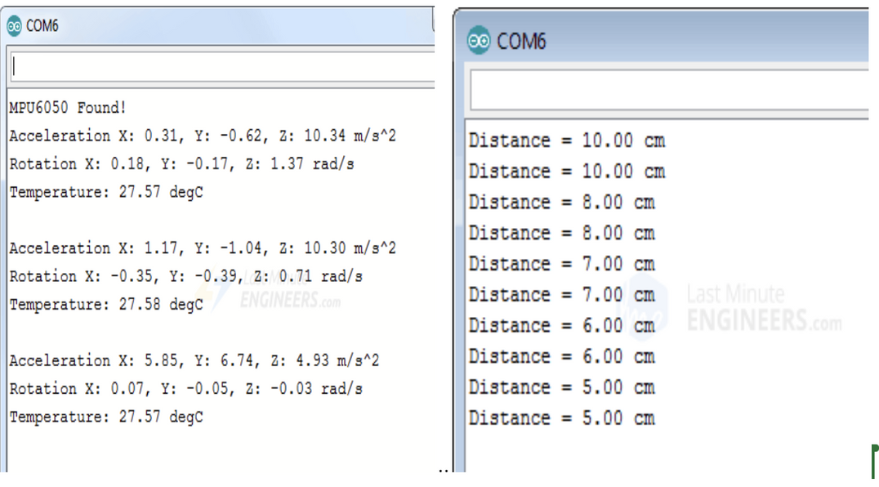

7
OUTPUTS
Transmitter Side
Receiver Side
IMU SENSOR READINGS
Ultrasonic Sensor READINGS
MOTOR DRIVER’S OUPUT
+VCC
Motor R
Time
-VCC
Voltage
+VCC
Motor L
Time
-VCC
Forward Motion
Backward Motion
Right
Turn
Left
Turn

Slide 8
8
LIMITATIONS & FUTURE SCOPE
1
Accuracy and Sensitivity: Ensuring precise translation of hand gestures into desired movements and also expanding output motor driver voltage values according to the degree of rotation instead of taking constant value .
IIT BHU | 2024
Range of Motion: Defining comfortable and user-friendly hand movements for each command while also expanding the variety of gestures to allow for a broader range of specific tasks.
2
3
Wireless Reliability: Maintaining consistent and reliable communication between the controller and the robot car.

Slide 9
9
REFERENCES
1. Daud, A. “Hand Gesture Based Robotic Mobile Loader Submission Form for Final-Year,” 2014.
2. Mishra, A. and Malhotra, S. “Design of Hand Glove for Wireless Gesture Control of Robot,” Int. J. Pure Appl. Math., vol. 114, no. 8, pp. 69–79, 2017.
3. Krishna, B. S. B. V. and Rao, P. M. “Implementation of Two Wheeled Self Balancing Platform,” pp. 1237–1241, 2016.
4. Tangan, G. and Robot, M. “Kendali Mobil Robot Menggunakan Isyarat Tangan,” J. Electro Luceat, vol. 6, no. 2, 2020.
5. Taha, I. A. and Marhoon, H. M. “Implementation of controlled robot for fire detection and extinguish to closed areas based on Arduino,” Telkomnika (Telecommunication Comput. Electron. Control., vol. 16, no. 2, pp. 654–664, 2018.
6. Karam, M. “A framework for research and design of gesture-based human computer interactions,” Science (80-. )., no. November, p. 198, 2006.
7. Qureshi, M. O. and Syed, R. S. “The impact of robotics on employment and motivation of employees in the service sector, with special reference to health care,” Saf. Health Work, vol. 5, no. 4, pp. 198–202, 2014.
8. Sidqi, R., Rynaldo, B. R., Suroso, S. H., and Firmansyah, R. “Arduino Based Weather Monitoring Telemetry System Using NRF24L01+,” IOP Conf. Ser. Mater. Sci. Eng., vol. 336, no. 1, 2018.

Slide 10
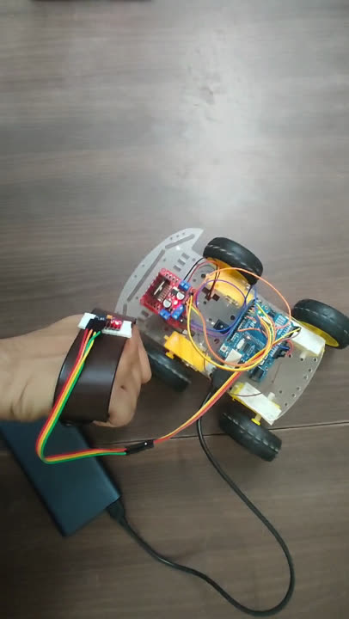

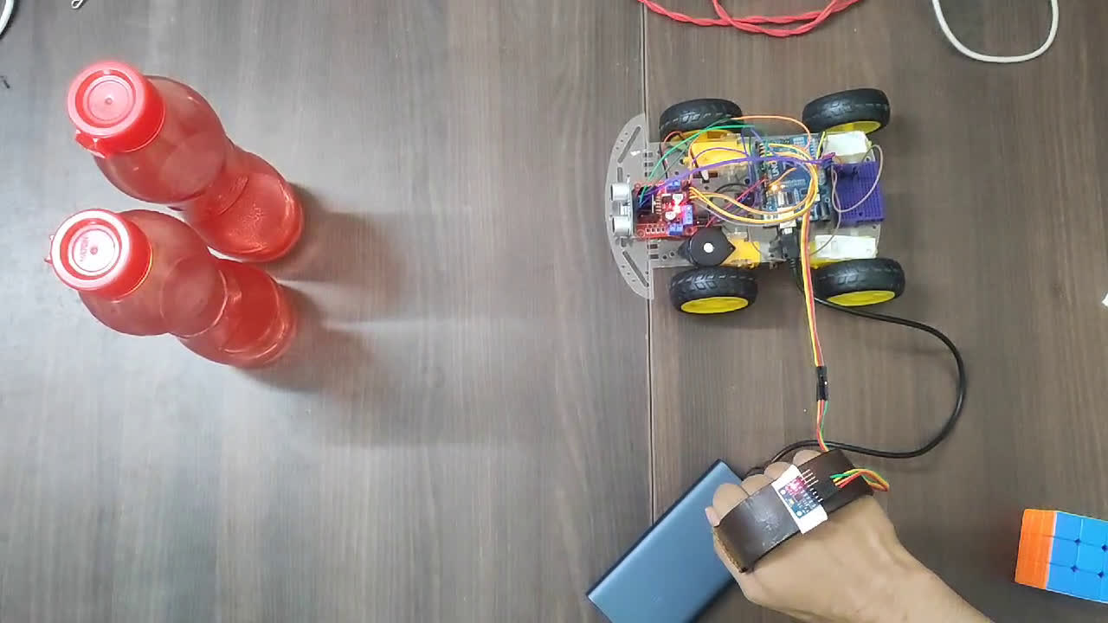

10
TEST VIDEOS
IIT (BHU) | 2024

